Slide 1
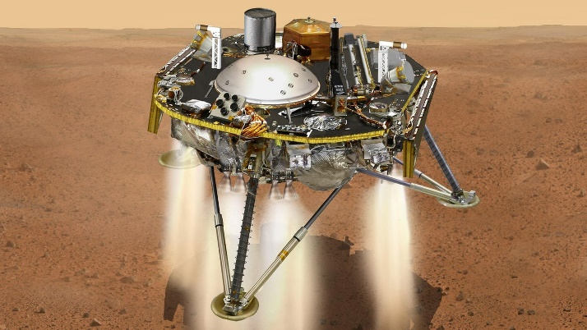
The Robots Have Landed!
An introduction to Robotic Process Automation (RPA) @ Our Library
Ian Gifford (Head of Digital Development)
Nilani Ganeshwaran (Senior Software Developer)

Slide 2

Today’s Take 30 Session
Presentation
  What is RPA and why should we be using it (Ian)
  What have we been doing with it in the library (Nilani)
Q&A
Discussion
  How can RPA help you?

Slide 3
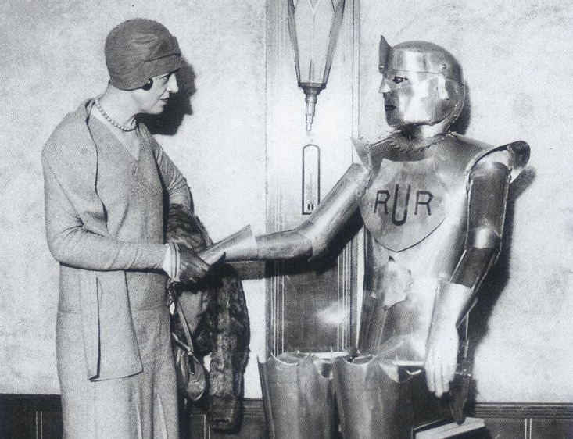
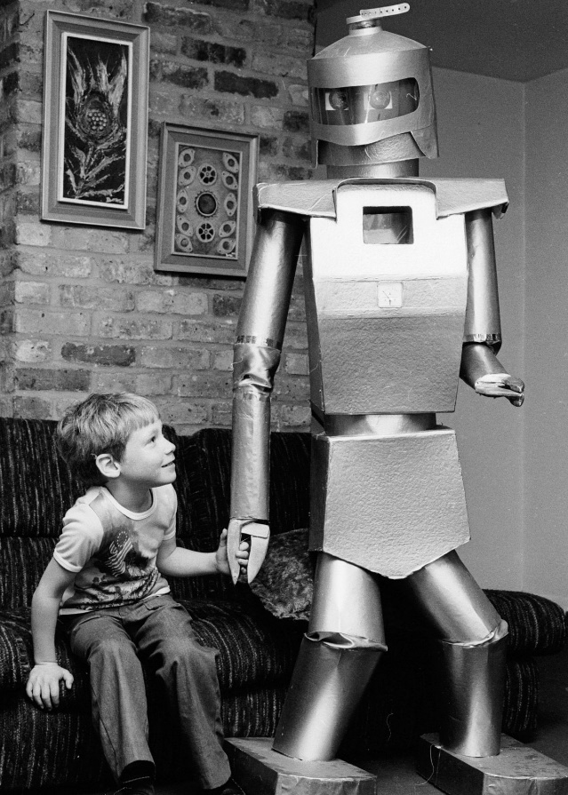
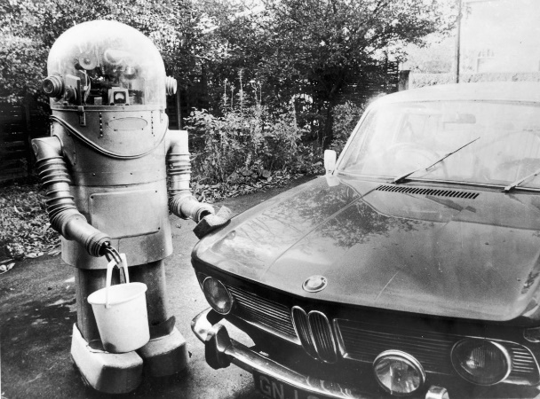
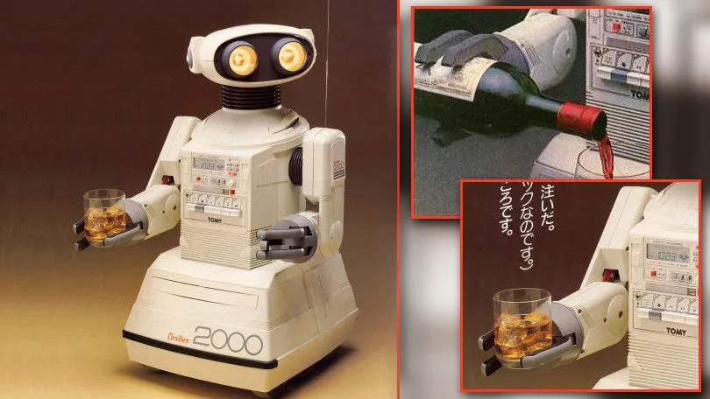
Robots.…Humanity’s best friend?

Slide 4
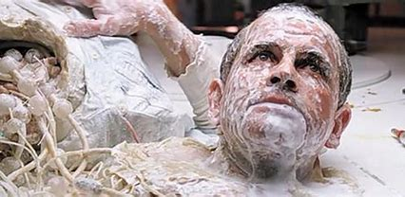

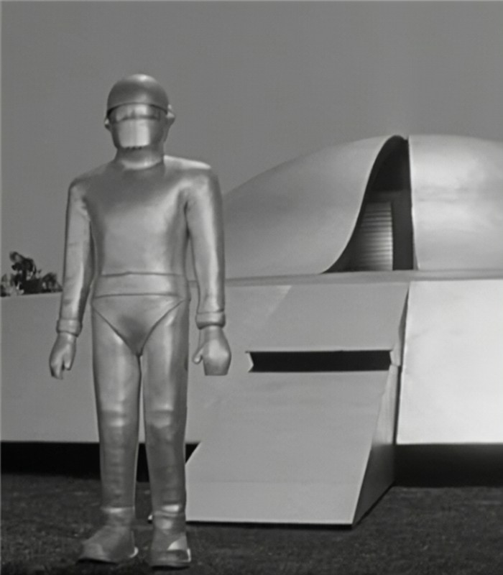

Robots….Or worst enemy?

Slide 5
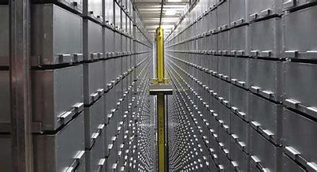
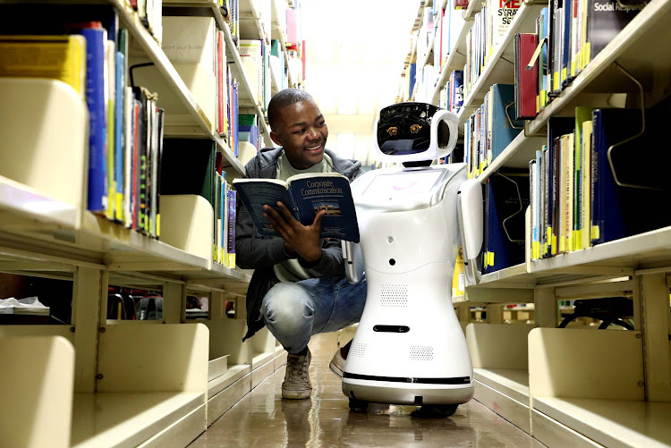

Robots in the Library

Slide 6

Our robots…..

Slide 7
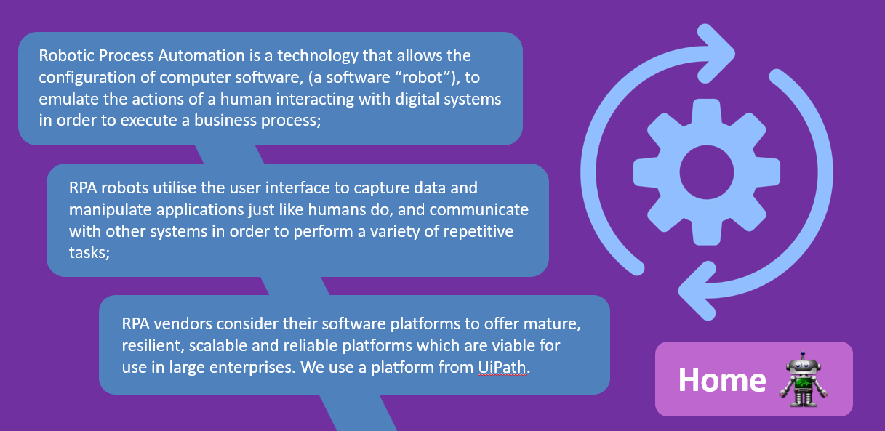

What is RPA?

Slide 8
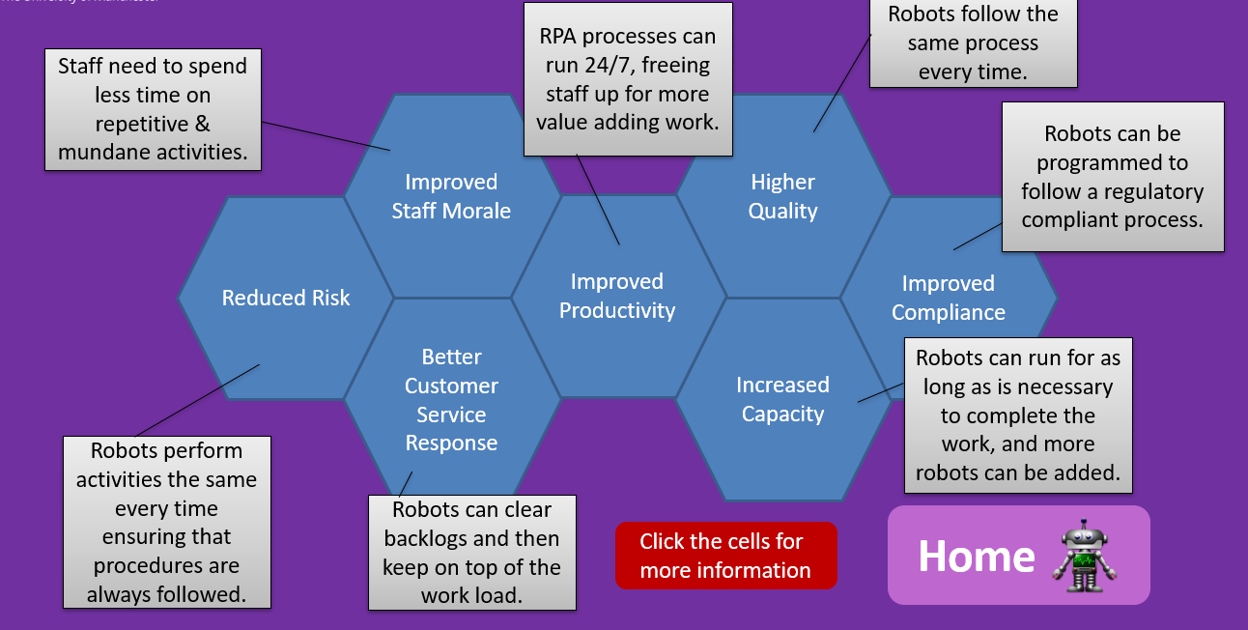
Why use RPA?

Slide 9
Library RPA Journey
2018
  RPA introduced by ITS partner through SEP
2019
  ITS establish automation team to utilise RPA across Uni
  Research services develop first library robots
2020
  Digital team initiate pilot project with ITS to enable library developers to utilise ITS platform (UIPath)
2021/22
  Library team transition RS robots into service and develop new robots to support other parts of the Library

Slide 10
We work closely with ITS’s RPA team
ITS uses UiPath, so we use it too
ITS manages the RPA virtual machine and the orchestrator
ITS provides us with guidance and support throughout the entire cycle
Both teams have regular conversations and knowledge-sharing sessions

Slide 11
Identifying suitable processes
Is the process repetitive and manual?
How often is the processes used?
How long does it take to complete the process manually?
Are decisions made mainly based on clear business rules and pre-defined logic?
Will the process change in the next 6 months?
Will automation of the process deliver tangible benefits such as improved customer satisfaction?

Slide 12
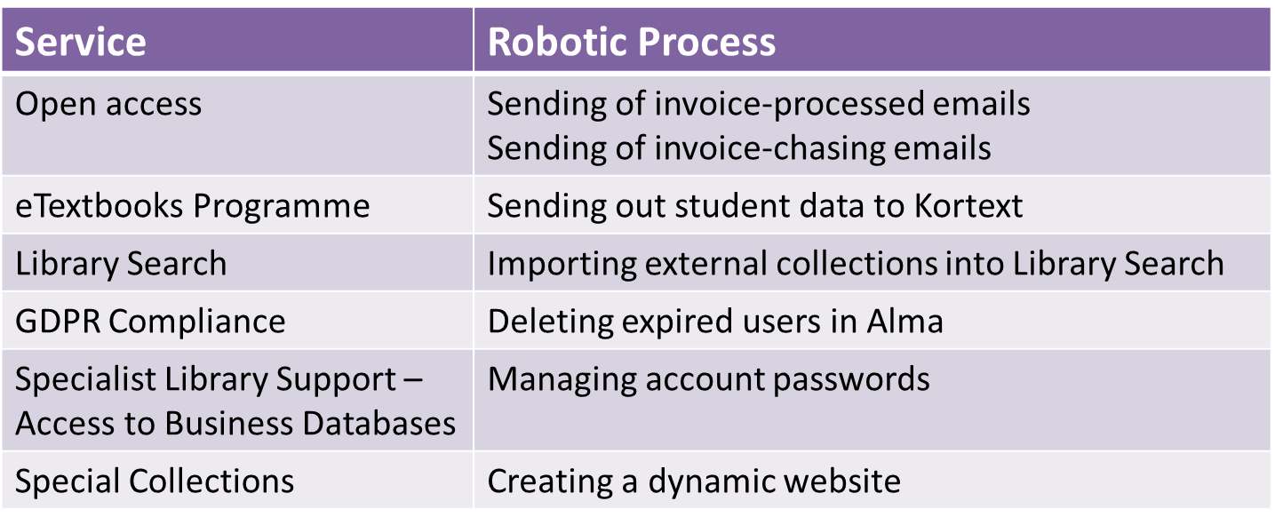
Services underpinned by Robotic Processes
Is the process repetitive and manual?
How often is the processes used?
How long does it take to complete the process manually?
Are decisions made mainly based on clear business rules and pre-defined logic?
Will the process change in the next 6 months?
Notes:
s

Slide 13
‘Invoice-processed’ emails
The robotic process accesses the Library’s Open Access management tool on a nightly basis, to identify records where the invoice was processed during the day.
Craft a personalised email to each researcher to inform them that their Open Access invoice has been processed, and timeframes for payment to their publisher including details of their research output and the cost of their invoice.

Slide 14
‘Invoice-processed’ emails
“Automating this process ensures that authors receive timely communication regarding their invoices, avoiding worry or additional enquiries to the Library’s Open Access and Subscriptions teams, and results in significant time savings through avoiding the need for colleagues to manually draft individual emails.”
Lucy May
Research Services Manager

Slide 15
‘Invoice chasing’ emails
The robotic process accesses the Library’s Open Access management tool on a nightly basis, to identify records where:
funding was approved 30 days ago
payment to the publisher will be handled via invoice
an invoice has not yet been received
The robot crafts a tailored email to the researcher requesting that an invoice be provided within 1 month.

Slide 16
‘Invoice chasing’ emails
“Historically, invoice chasing has been a resource-heavy task, with significant risks to timely and accurate budget management if staffing capacity is reduced. Automating the process is one of the important steps made over the past year to improve Open Access budget management.”
Lucy May
Research Services Manager

Slide 17
Student data to Kortext
The eTextbooks Programme is part of our Reading Lists service. It provides each student on a module with unlimited, continuous access to an interactive electronic textbook provided by Kortext.
The robotic process sends over 100k student records on 825 course units on a daily basis to Kortext.
It is now easy to manage changes to course units, eTextbooks and student details.

Slide 18
Student data to Kortext
“Using RPA to transfer student data to our supplier Kortext has reduced delays in accessing etextbooks dramatically. Manually transferring data meant it could take over a week to provision eTextbooks to students – now it takes less than 24 hours. This has not only significantly improved the operational efficiencies within the Teaching Collections team, but crucially has ensured seamless access to core eTextbooks.”
Flora Bourne
eTextbook Programme Co-ordinator

Slide 19
External collection into Library Search
“This has also allowed the AIU RACE Centre’s records to be imported into Library Search on a monthly basis, instead of twice yearly. In addition to this, the robotic process ensures full metadata for the records can be extracted from Spydus for use within Library Search, in turn enhancing the discoverability of the Ahmed Iqbal Ullah’s collections within the University.”
Amanda Swann
Systems Support Analyst (Library Systems)

Slide 20
Expired user management in Alma
“By automating the process of deleting user accounts from Alma (library management system) to run on a monthly basis via RPA, this has ensured our compliance with data protection regulations (such as GDPR) and the university’s records retention schedule in a more robust manner. This has also removed the reliance on an individual to manually run the process every month, freeing up time with the team.”
Amanda Swann
Systems Support Analyst (Library Systems)

Slide 21
Password management system
The financial and business databases Eikon and DataStream have a complicated booking system, where 400 students and researchers have to book a slot with one of a pool of 20 “Eikon IDs” which are used by both platforms.
RPA creates a unique password management system by automatically generating random passwords for all the IDs on a monthly basis and updating EIKON and Resource booker login passwords accordingly.

Slide 22
Password management system
“Thanks to the Digital Development team and their work with the RPA system, TLS has been able to save hours of tedious and repetitive work every month. Everything has run very smoothly. The system has been running for two years now with over 2,500 secure Eikon/DataStream bookings.”
Phil Reed
Teaching and Learning Librarian (Data Specialist)

Slide 23
Dynamic website
Generates a dynamic web presence for the Guide to Special Collections by automating the export of data from eMu to Alma and then generates an A-Z html file and a search XML file of all items for use by T4.
Previously, it was a labour intensive and time-consuming process to keep the website up-to-date

Slide 24

Any Questions?

Slide 25


