Slide 1
Airing our Rags in public: communicating controversial collections
Content warning for discussions of racism, sexism, ableism and abuse, as well as other potentially sensitive or offensive material
Grant Collier and Charlotte Hoare
16th June 2022

Slide 2
Communicating controversial collections
Issues of what (and how much) to show
‘Censorship’/ignoring issues vs. giving offence, trauma
Potential for accidental accessing of digital content
Exposes social/political injustice
Most often human stories with tangible impact on lives
Emotional/educational impact is higher
Reputational risks are far higher
They are controversial precisely because people care

Slide 3
Content warning:
This section of the presentation presents examples of sexist and racist content in the ‘Rag Rag’ student magazine

Slide 4
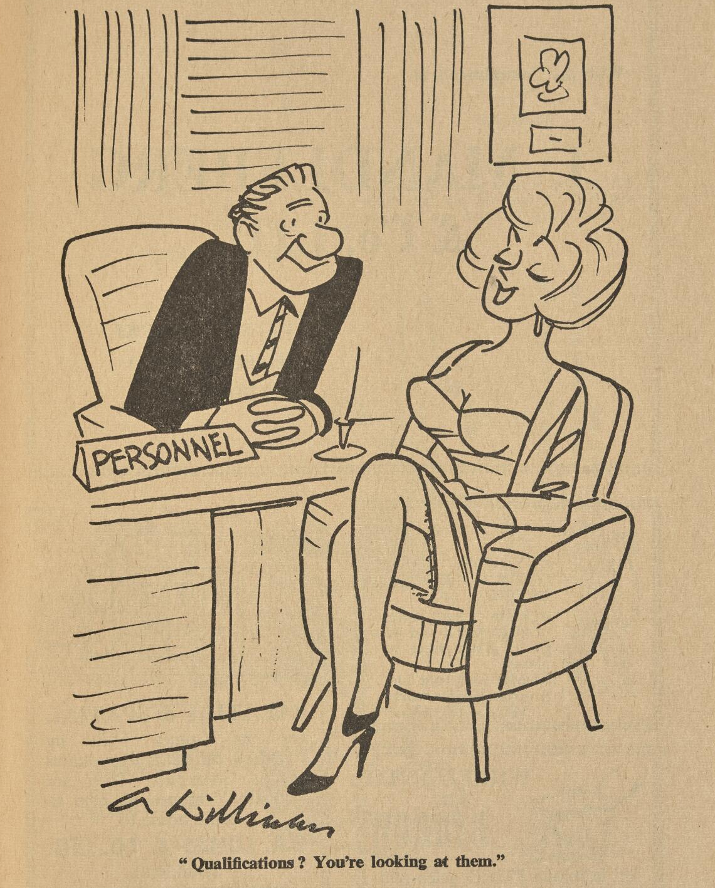
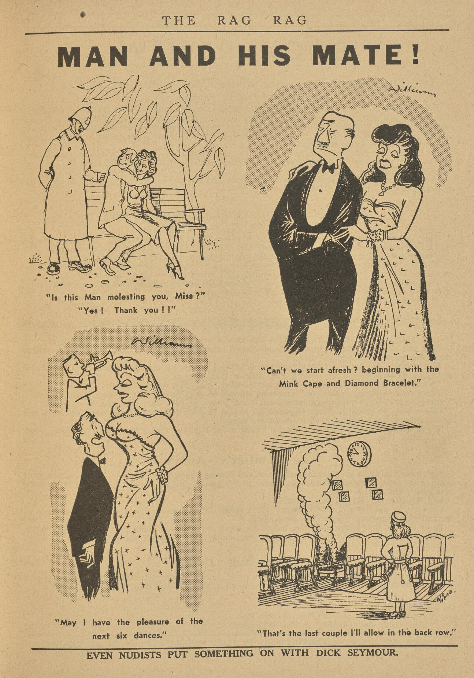

Slide 5
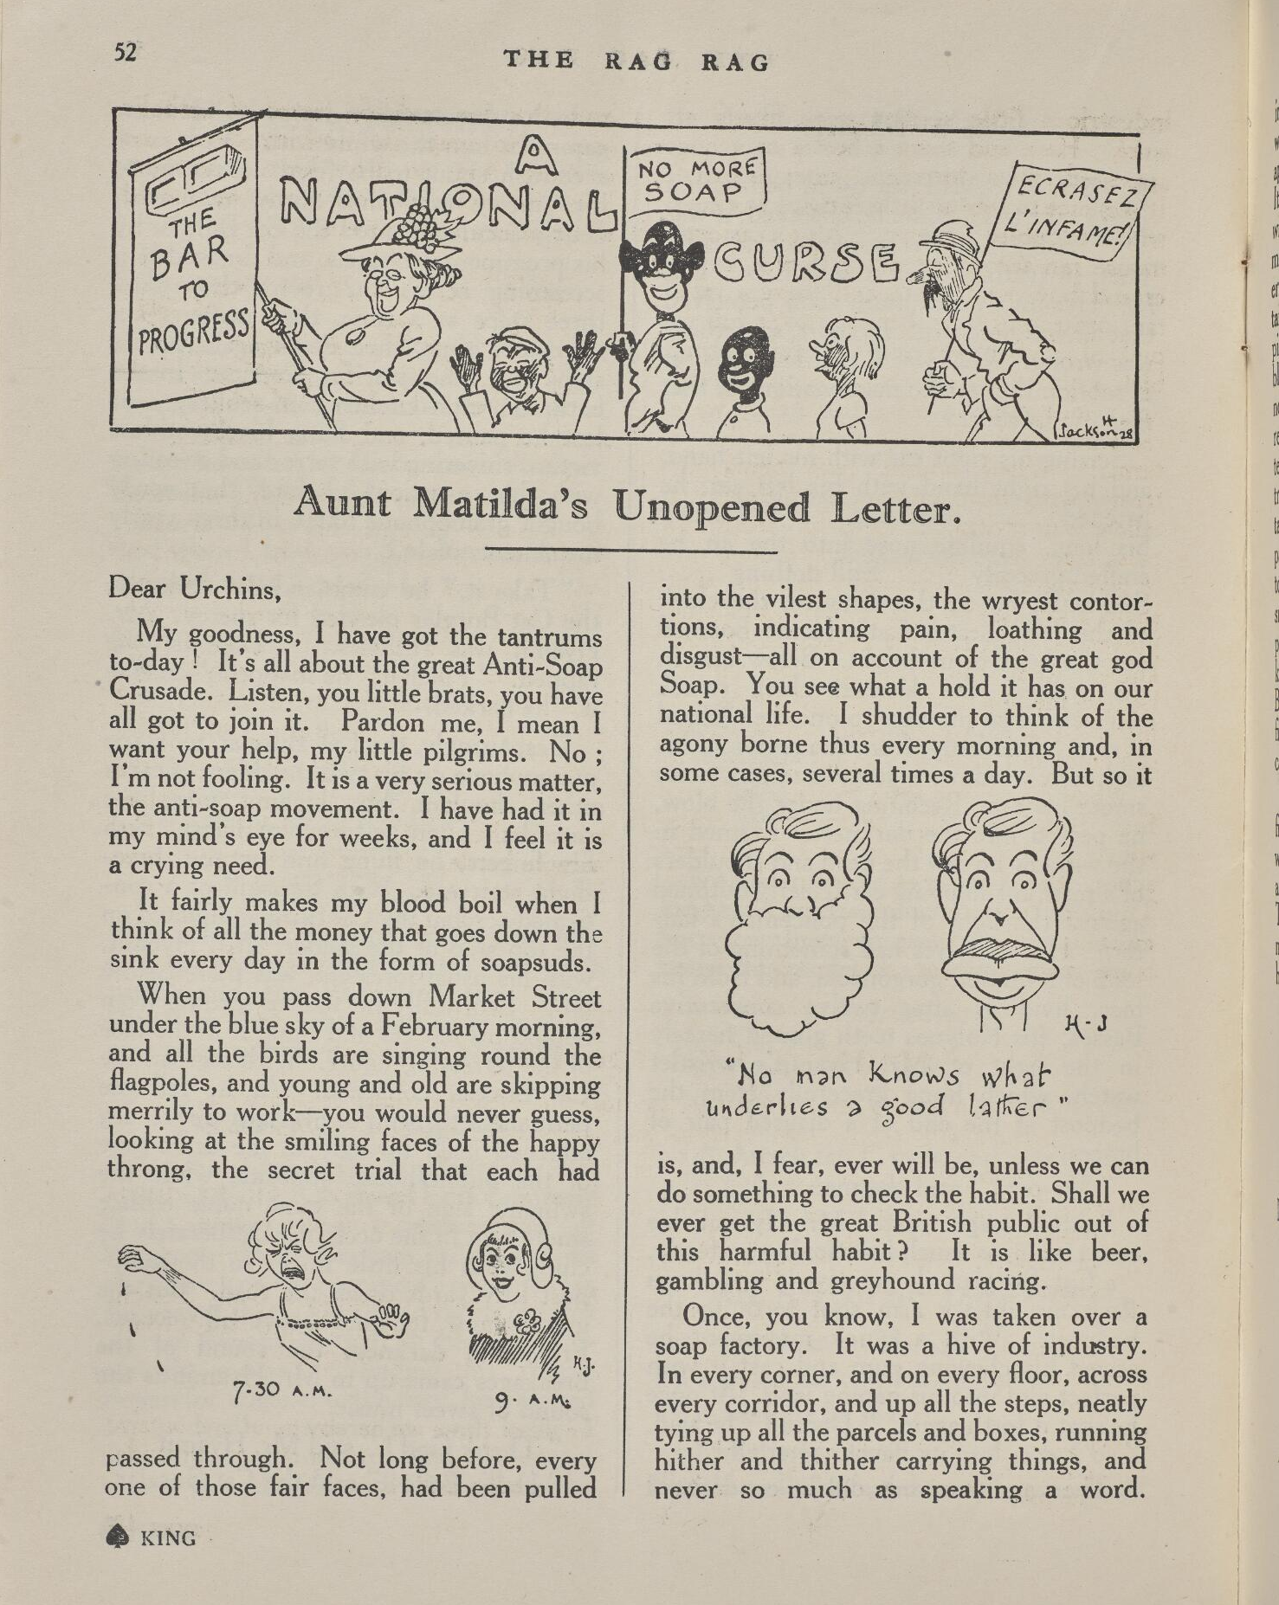
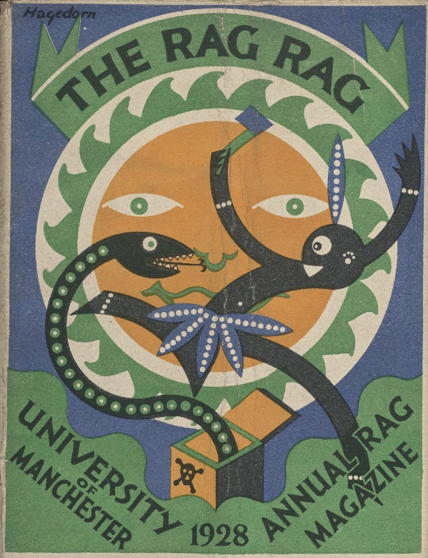

Slide 6
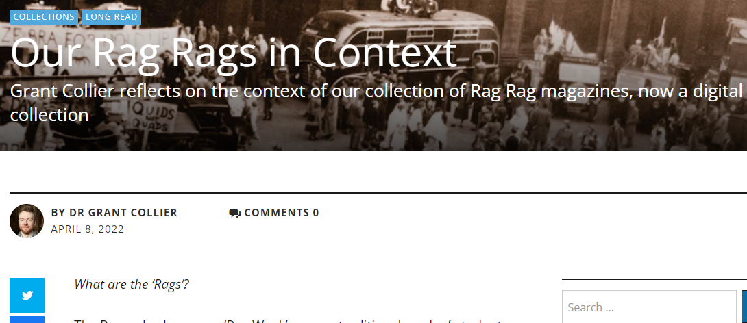
Framing on social media

Slide 7
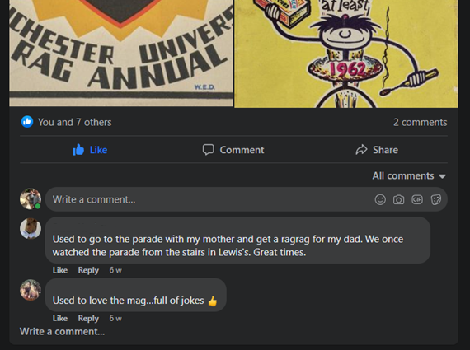
Discussing controversial content
How to respond to different audiences’ interpretations of controversial content?
What is an appropriate
institutional voice?

Slide 8
Complications: other stakeholders
Christian Brethren Archive
Manchester Science Park

Slide 9
How the process works
Images, metadata and manifests created/enhanced
Proposal considered by MDC ‘Forward Planning Group’
Collection reviewed and amended as necessary
Proposal
Planning
Prep
Review
Staging
Publish
Collection scheduled and a project checklist created
Processed by Digital Technology team and uploaded to Staging site
Collection made live

Slide 10
Rag Rags and MDC
A LUNA transfer (prioritised during lockdown) - some existing digitisation, some legacy metadata. Process of conversion, enhancement
Cross-team process means many people are working with the content. Discussed widely across MDC governance groups
Revised proposal process to flag content earlier – more time to reflect/research/consult (not appropriate to be deadline-driven)
More to do: holistic approach and standards, consideration of internal handling as well as end user

Slide 11
Open books: Digital collections
"Digitisation increasingly mediates the stories we tell ourselves about the past” (Kate Holterhoff, Race and the Digital Image Archivist, 2017)
Primary materials are made available "immediately, unexpectedly and intimately... The remix is the very nature of the digital" (William Gibson, 2005)
Balancing access with accountability, context and choice

Slide 12
Things to consider
Accountability: who is accountable for the content we publish and who are we accountable to?
Context: how do we provide appropriate context? Metadata is key (professional ethics, participatory practice): "Cataloguing moves have deep political power" (Derrick R. Spires, 2020)
Choice: do our users and colleagues have a choice about the material they see? How can we foreground this choice (content warnings, site functionality etc.)

Slide 13
Discussion points
Immediate responses to this content?
What do successful ways of talking about controversial collections have in common?
How can we support each other to approach difficult topics appropriately?

Slide 14
Thank you
We will use notes from this discussion to inform wider practice.

