Slide 1
Game of Life: Students, Class and the Library

Slide 2
Game of Life: Students, Class and the Classroom
Menti.com: 9254 2325
Adam Cooke Teaching Learning and Students Officer (WP)
Sam Aston Learning Developer
Kerry Scott Teaching, Learning and Students Co-ordinator

Slide 12
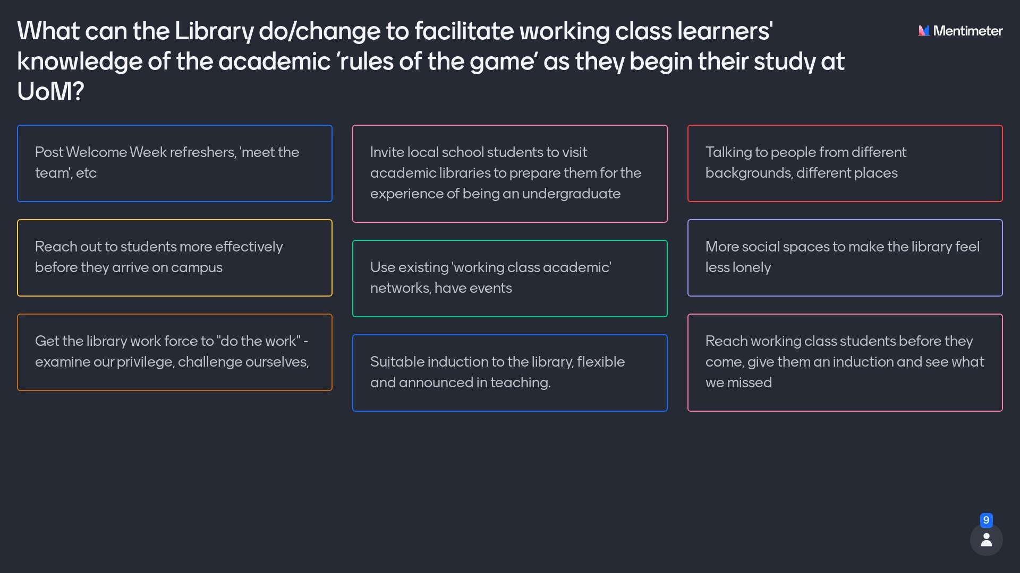

Slide 13
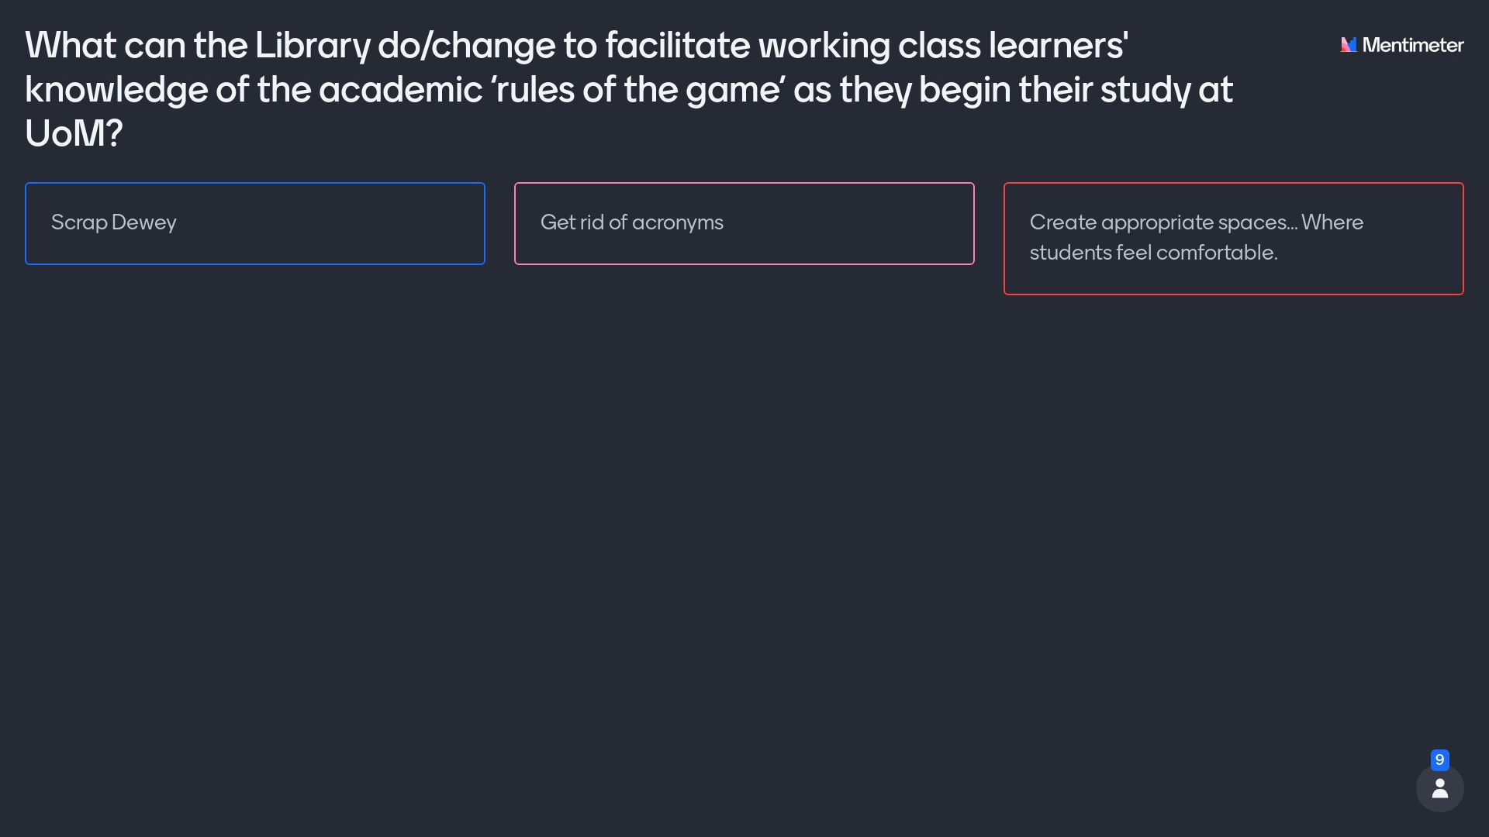

Slide 14
Thank you!

