Slide 1
Beyond Together
Education for the Community
Maya Sharma, RACE Centre
Adam Cooke, Teaching Learning and Students

Slide 2
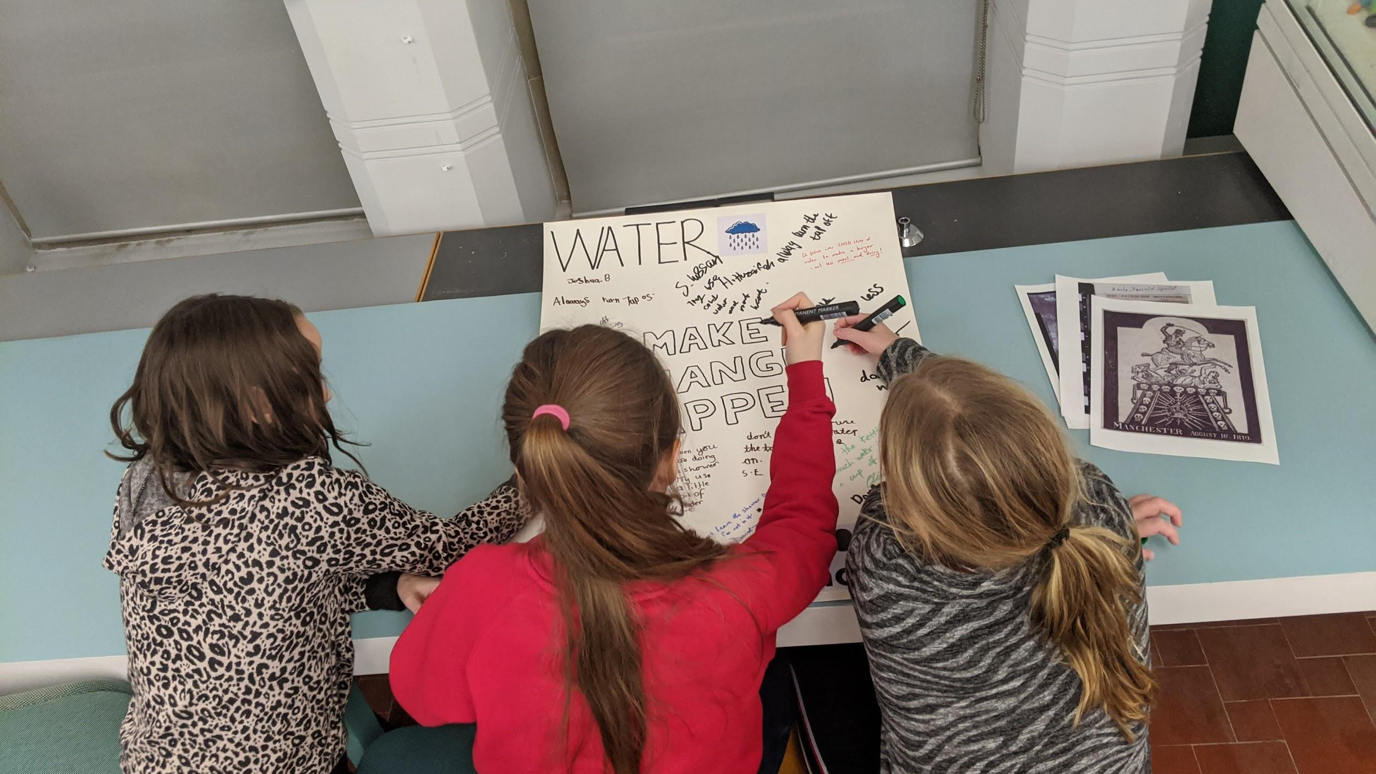
Collaboration

Slide 3
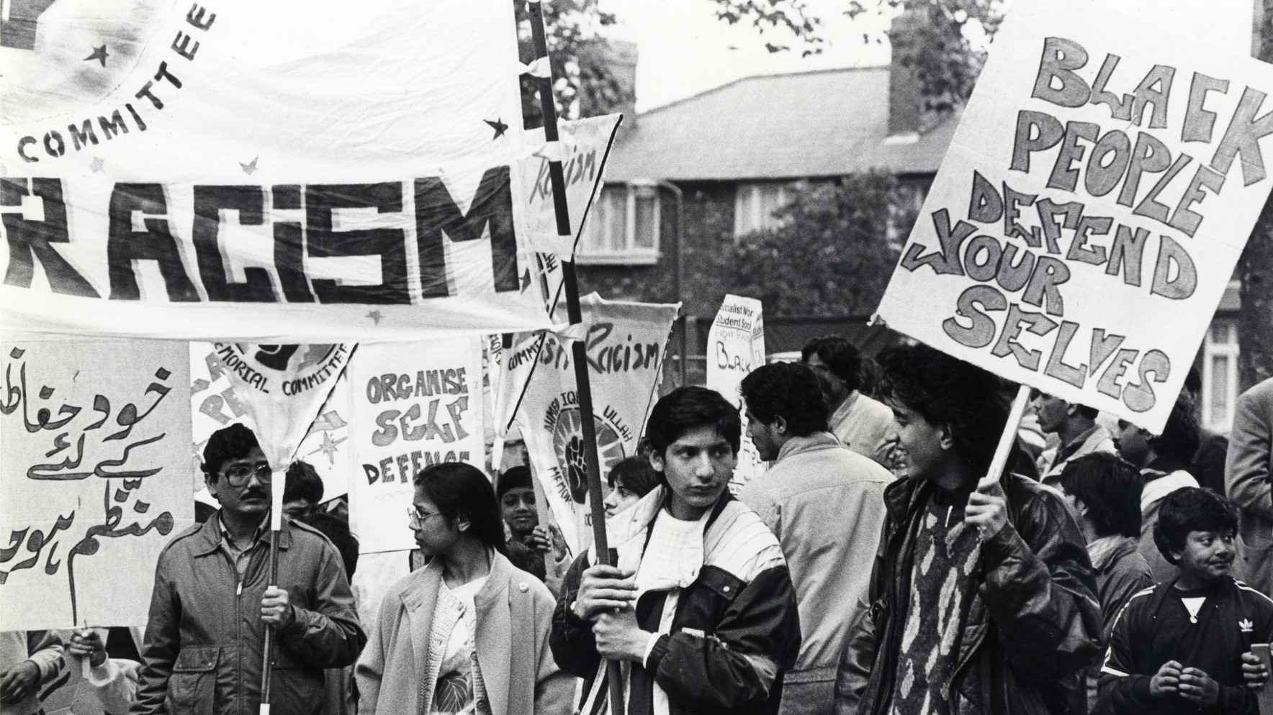
Ahmed Iqbal Ullah RACE Centre

Slide 4
Teaching, Learning and Students

Slide 6
padlet.com/acookewp/together
How could you collaborate for the global goals?

Slide 7
Thank you!
Maya Sharma, RACE Centre
Adam Cooke, Teaching Learning and Students

