Slide 1
Collaboration and metadata creation: our partnership with Manchester University Press
Veronica Pizzarotti
Metadata Assistant
16 June 2022

Slide 2
Collaboration timeline
2017 to 2019
2020
2021
2022
Phase 1
Phase 2
Phase 3
Phase 4
Start & Legacy records
Records for new ebooks
Consolidation
Exploration: Linked Data

Slide 3
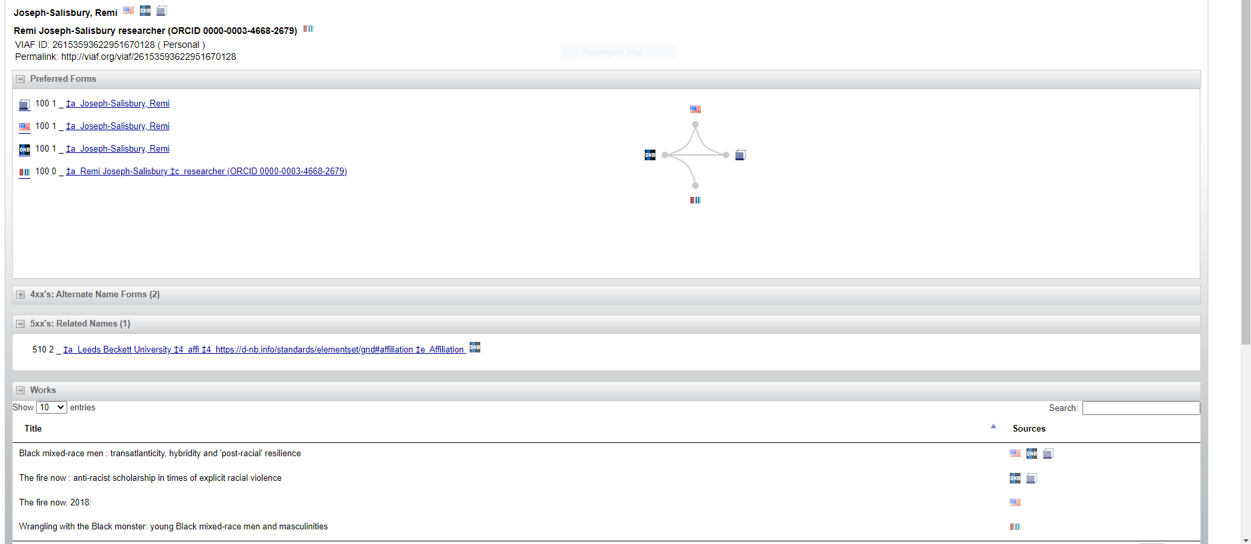
LINKED DATA EXAMPLE

Slide 4
STRATEGIC LINKS
Collaboration grew thanks to people and quality of metadata
Collaboration led to experiment with metadata
Strategic support of Open Access content
Strategic support of research

