Slide 1
Phil Reed SFHEA (he/him)
Active staff inductions for a Specialist Library Support service
16 June 2022
Notes:
Within the Specialist Library Support (SLS) service, colleagues support one or more specialist library areas, however they may not initially have any relevant expertise. Phil has built an active induction model as part of his PGCert coursework to define, measure and encourage colleagues as they learn new areas so that they can better support students and researchers. In this session, practice using a sample of the framework and consider how it might be adapted to work with your team.

Slide 2
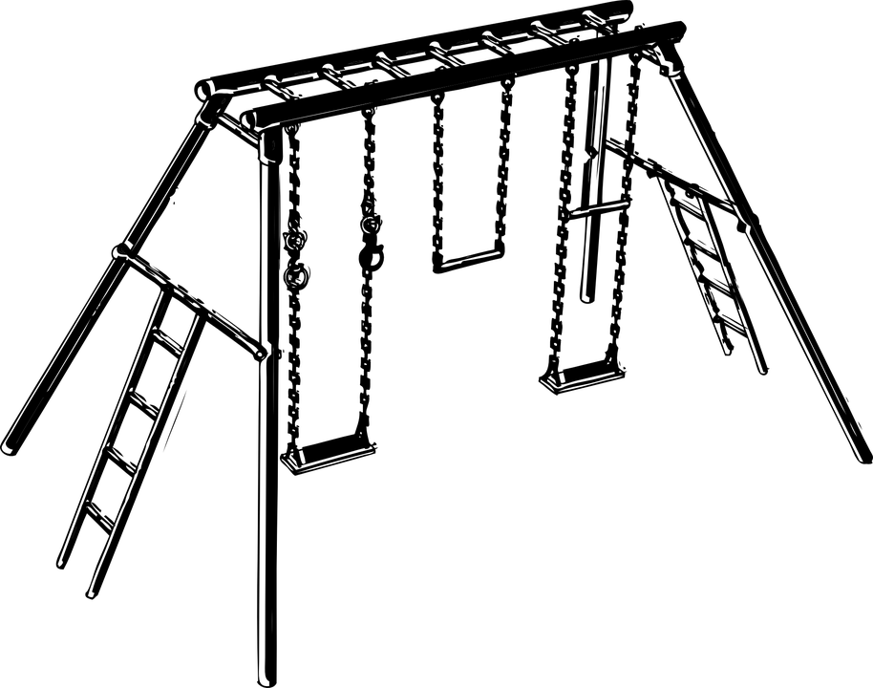
My development of competency framework for SLS staff
Case study
Image by Clker-Free-Vector-Images via Pixabay
Notes:
I will talk about my development of a competency and induction framework for staff in the Specialist Library Support team.

Slide 3
Specialist Learning Support has service areas
Copyright
guidance
Advanced searching and systematic
review
Business
data
Referencing
support
Notes:
The Specialist Learning Service was launched in September 2018, within the Teaching, Learning and Students division of The University of Manchester Library

Slide 4
What I did (in the PG Cert)
An interpretation of Chartered Institute of Personnel and Development (CIPD, 2020) ‘Competence and competency frameworks’
Applied to the roles and requirements within the Specialist Library Support (SLS) service, building a service induction framework
Scope | Membership​ | Competency types
Baseline | ​Team-wide​ | Common
For each area | Service member ​ | Common and Technical
Out of scope | Service expert | Technical and Leadership
Notes:
I shall start by explaining what this is and where it has come from.
My framework is an interpretation of Chartered Institute of Personnel and Development (or CIPD) paper titled ‘Competence and competency frameworks’. I have applied it to the roles and requirements within the Specialist Library Support (or SLS) service.
I listed out the responsibilities for the baseline and each specialism. I am working with the service leads to complete these responsibilities. For example, in the baseline, we would expect everyone to be able to find the titles of all the referencing service workshops and recognise enquiries which need to be triaged to referencing team members. For referencing service members, we would expect them to be able to deliver all of those workshops and answer all but the most expert referencing enquiries.
The idea is that each new person joining the SLS team would know if they were part of a specialist area, and all of them would be part of the baseline. They could then work through the framework and assess for themselves how confident they were at each of the points. Following on, they could build up a personal development plan with their line manager, if required.

Slide 5
Why I did it
Long term complaints from staff joining SLS that that they do not know what is required for them to learn; work shadowing isn’t enough
Similar complaints from service leads that staff joining them who don’t have experience in that specialist area are not developing
Part of my Local Academic Culture module in my PGCert:
Reflective practice with ethnographic research (Hammersley and Atkinson, 2007)
Chose CIPD model (CIPD, 2020)
Notes:
So, why have I been working it, and why have I done it this way?
For years, there have been complaints from staff joining SLS that that there is no clear path to learn what is required of them. The approach of shadowing, or observing then delivering a workshop does not provide adequate development opportunities.
There have been similar complaints from service leads that staff joining them who don’t have experience in that specialist area. The joining staff are not dedicated to any one service area so they need more structure and support to learn. For example, when I started in the Library, I was working just in the business data field. The immersion and focus offered would be enough for me to learn what I needed. In recent years, the team does not work that way.
I took the Local Academic Culture and Reflective Practice module as part of my PGCert in HE course. As part of my assignment, I applied an approach of initial reflection, practitioner research data collection, then further reflection to create a plan of action.
For my method of data collection, I chose to use interviewing as it is a valuable source of data (described in Hammersley and Atkinson, 2007), combined with a selection of meeting notes (from Cohen et al., 2011). I looked at some work that the team had done before regarding team staff development.
After summarising the data and further reflection, I came up with some recommendations, including ‘design a competency framework following CIPD guidance, with consultation from colleagues’.
Over the following 12 months, I have started to build the framework. I have updated some of the details following further discussions with managers.

Slide 6
Impact and reflection
What we hope to achieve from it?
Clearly describe the development requirements for SLS staff and managers, especially following the Library Reshaping Project
Improve confidence, engagement and retainment of newer staff
Adapt and apply the approach in other teams in Library (you!)
Notes:
What we hope to achieve from developing and implementing this framework?
We will be able to clearly describe the development requirements for SLS staff and managers, something which is especially important following the ongoing Library Reshaping Project (or restructure).
Colleagues will be able to improve their confidence at completing regular and less regular tasks as part of their work. They will feel more engaged, and hopefully this means the retainment of newer staff.
Thinking further afield, colleagues will be able to adapt and apply the approach in other teams in Library; that is where you come in.
I will be monitoring the effectiveness of the framework and continually improve it..
These evaluations will be done in conjunction with colleagues working in the various specialist areas, particularly the area leads. So, in my capacity as business data lead, I will be planning and delivering the relevant induction programmes for new staff in that area.

Slide 7
Three phases
Long term, define three phases:
Competency framework and prioritised, personal action plans
Series of train-the-trainer sessions, semi live-blogged
Contribute to our programme of open educational resources

Slide 8
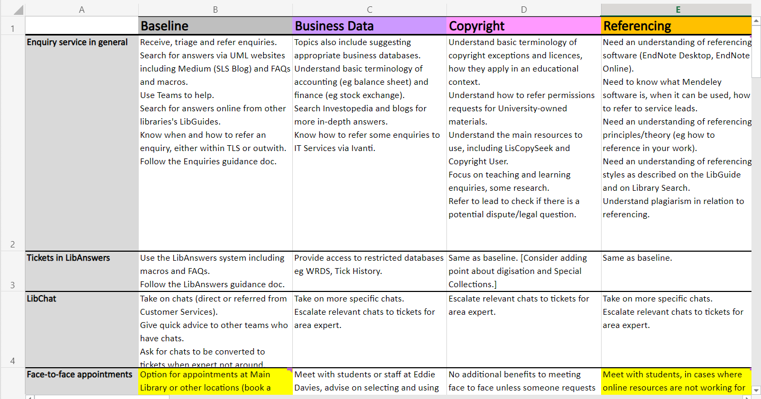
Example page of competency framework
Notes:
Several sheets
Each sheet has columns: (A) systems/topics, (B) baseline, (C onwards) each specialist area.
Each row contains competencies: knowledge or tasks.
The rows may be grouped.
There are common competencies across the team (baseline) and area-specific ones.

Slide 9
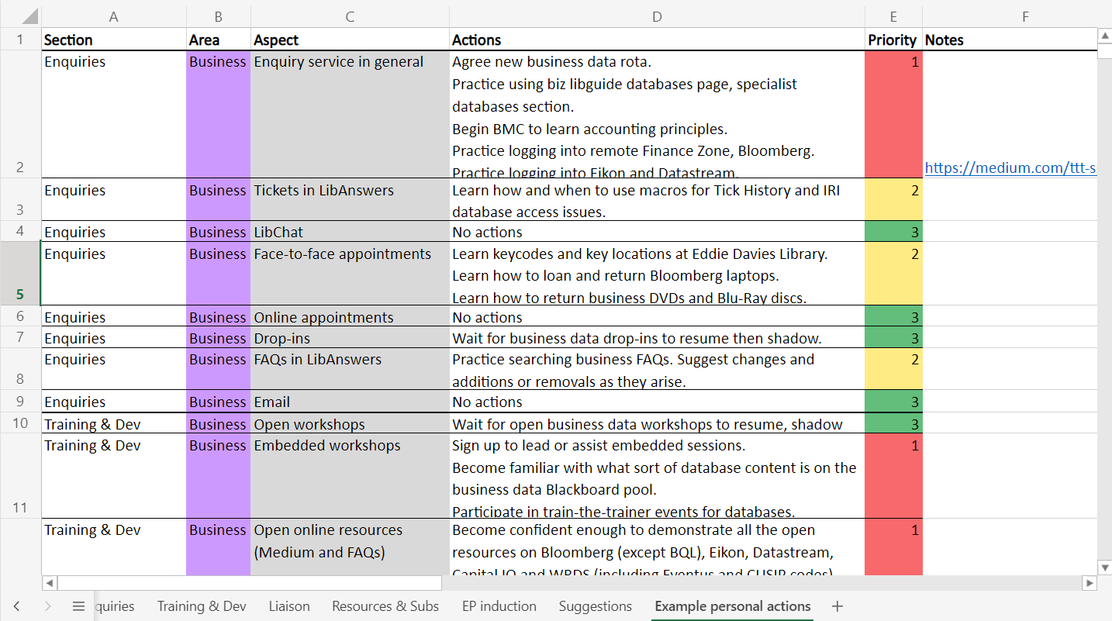
Example 1 of personal, prioritised action plan
Notes:
Each competency is listed. An individual may be assigned one or more areas.
Agree actions next to each competency.
Prioritise with a RAG status.

Slide 10
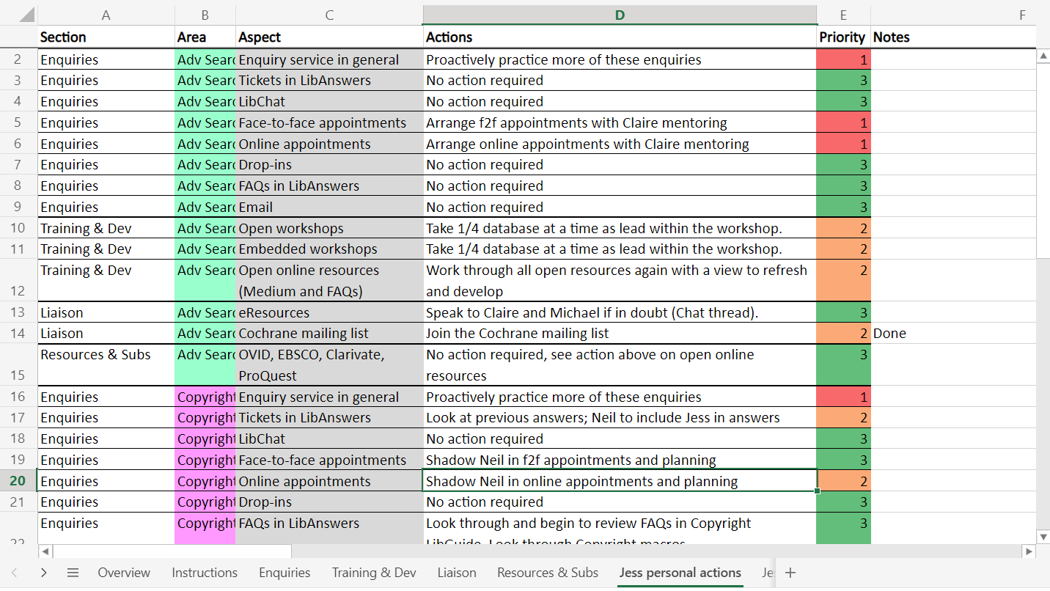
Example 2 of personal, prioritised action plan
Notes:
Each competency is listed. An individual may be assigned one or more areas.
Agree actions next to each competency.
Prioritise with a RAG status.

Slide 11
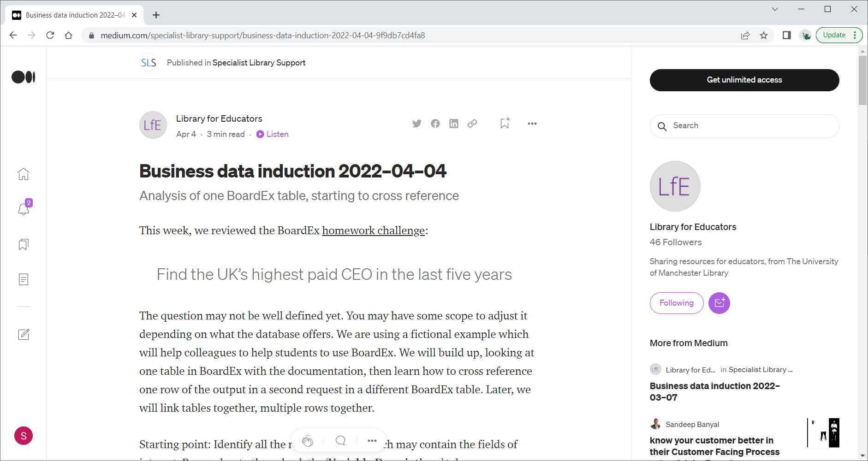
Example of blog posts from train-the-trainer
https://medium.com/specialist-library-support/staff/home

Slide 12
Over to you…
Congratulations, you are joining the referencing team! ☺
(at least for the next few minutes)
You will be given a sample of the SLS staff induction framework
You can look through the sample sheets then begin to complete an action plan
We will then review what you have done

Slide 13
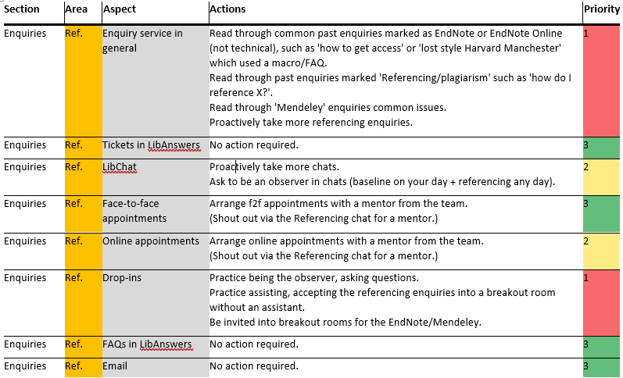
Example 3 of personal, prioritised action plan
Notes:
Each competency is listed. An individual may be assigned one or more areas.
Agree actions next to each competency.
Prioritise with a RAG status.

