Slide 1
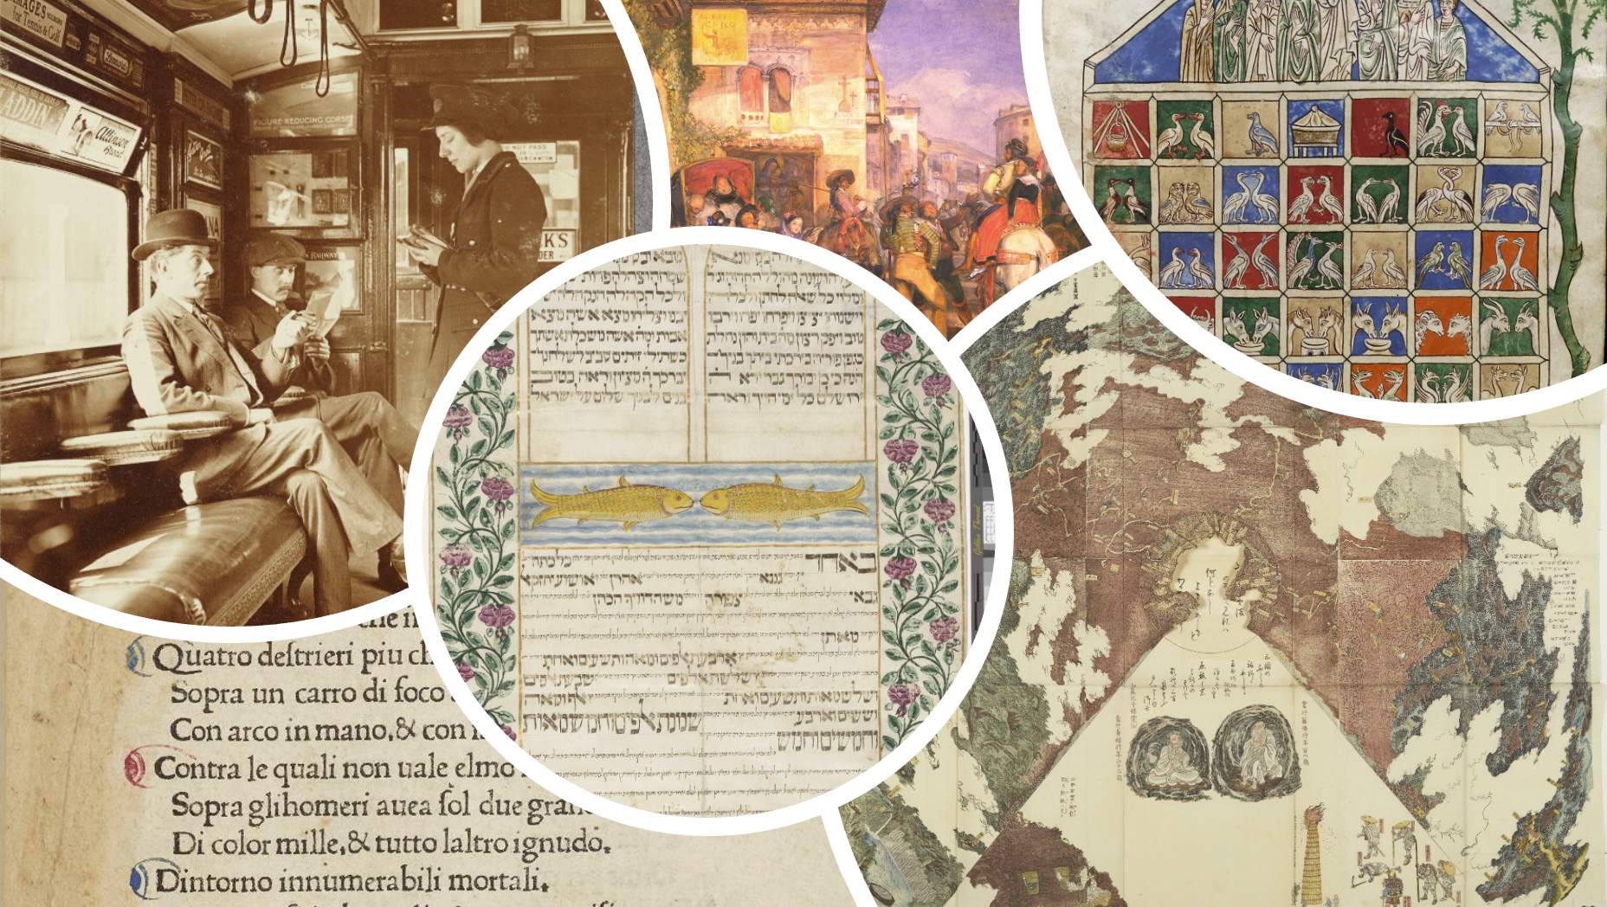
1 June 2022
Manchester Digital Collections
From TEI to Transcription
Tom Higgins
Digital Development
The University of Manchester Library

Slide 2
What is Manchester Digital Collections?

Slide 3
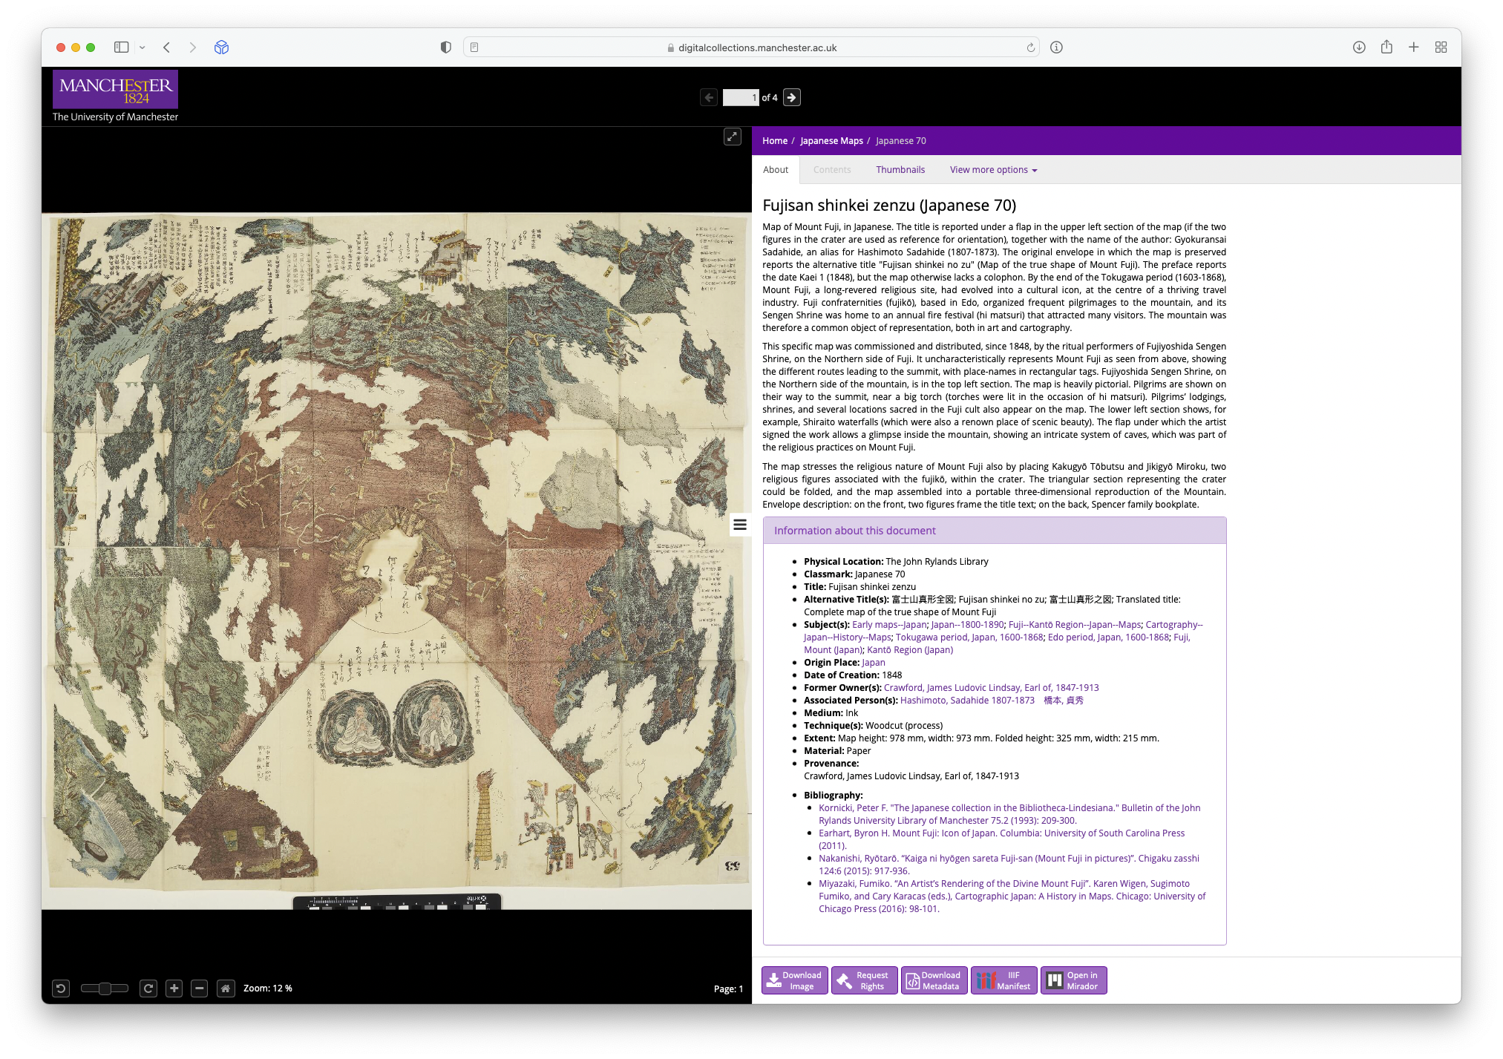
Zooming Images
(IIIF)
Metadata
(TEI-XML)

Slide 4
What is the Text Encoding Initiative?

Slide 5
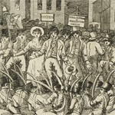
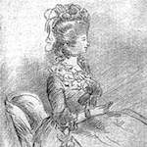
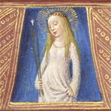
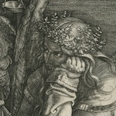
2019
365 Items
Jan | Feb | Mar | Apr | May | Jun | Jul | Aug | Sept | Oct | Nov | Dec
Peterloo
Soft Launch
Persian
Hebrew

Slide 6
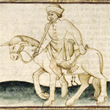
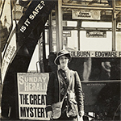
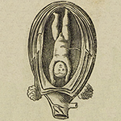
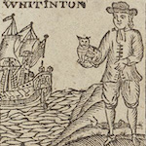
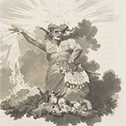
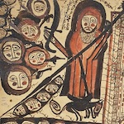
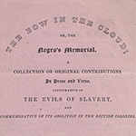
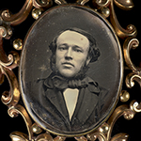
2020
596 Items
1238 Items
Jan | Feb | Mar | Apr | May | Jun | Jul | Aug | Sept | Oct | Nov | Dec
Papyrus to Print
Bow in the Cloud
Public Launch

Slide 7
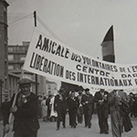
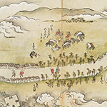
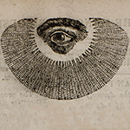
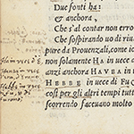
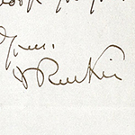
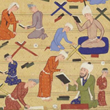
2021
1628 Items
2236 Items
Jan | Feb | Mar | Apr | May | Jun | Jul | Aug | Sept | Oct | Nov | Dec
Manchester Observer
New Schema

Slide 8
2022
3809 Items
Jan | Feb | Mar | Apr | May | Jun | Jul | Aug | Sept | Oct | Nov | Dec
Persian Refresh
Hebrew Refresh
Mary Hamilton Transcriptions
Simon Papers Transcriptions

