Slide 1
PUNJABI ms 5 The GURU GRANTH SAHIB ji Conserving a religious manuscript
Conservation project
Laura Caradonna –collection care lab, the john Rylands research institute and library

Slide 2
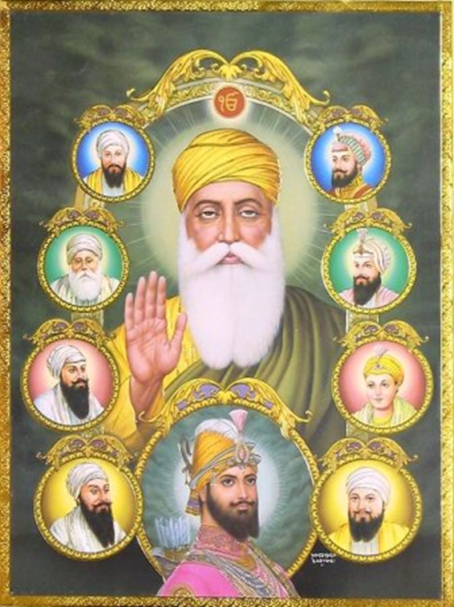
Sikhism
Sikhism is a monotheistic religion, founded in the Punjab by Guru Nanak in the 15th Century CE
Sikhism is based on the Guru's teachings, and those of the 9 Sikh gurus who followed him.
The most important principle in Sikhism is the internal religious state of the individual.
Sikhs believe that the way to lead a good life is to:
keep God in heart and mind at all times
live honestly and work hard
treat everyone equally
be generous to the less fortunate
serve others

Slide 3
The guru granth sahib ji
https://www.youtube.com/watch?v=h2LbTwwGsAY&feature=emb_logo

Slide 4
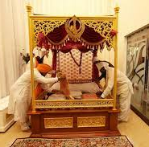
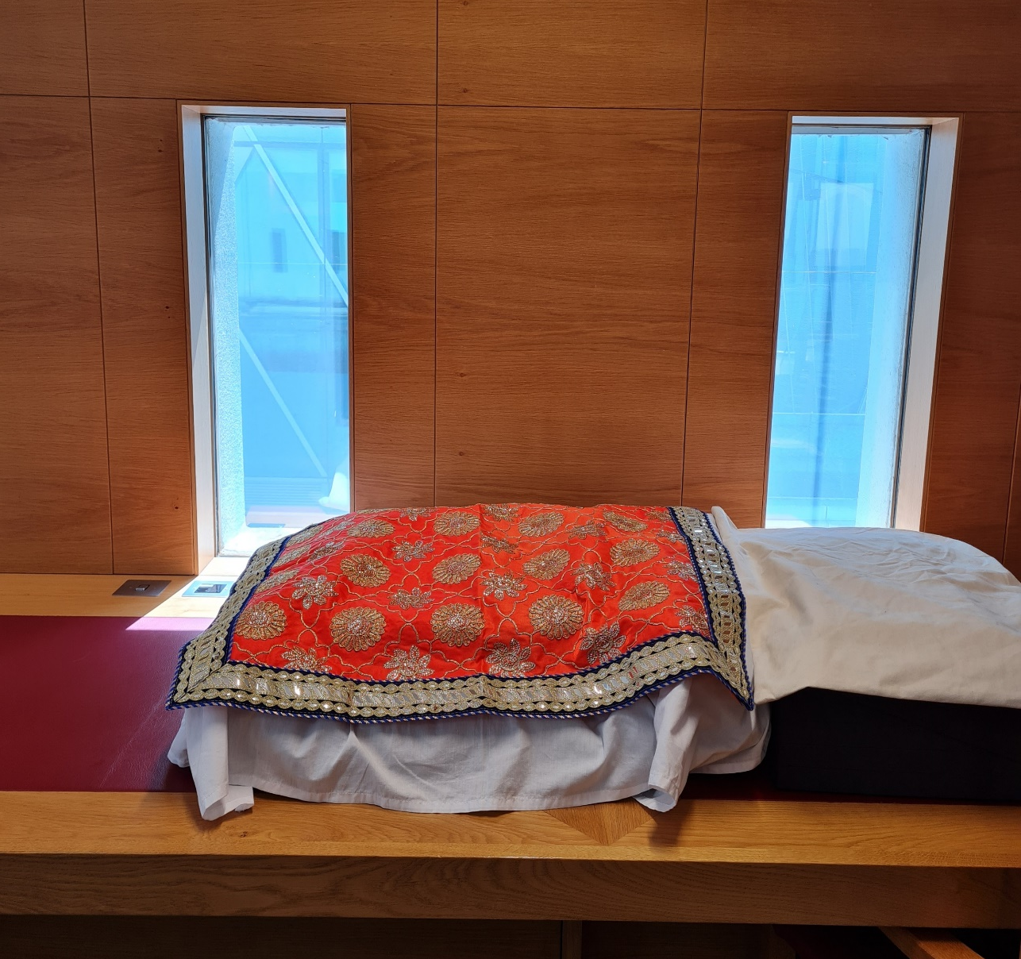
The guru granth sahib ji: storage in the library
Notes:
In accordance with the living Sikh tradition, the scripture is covered in two layers of clean cotton cloths, to protect from heat and dust, and it rests on a cushion with a canopy placed over it. This is replicated on the shelf where the manuscript rests in the storage area. The Guru Granth is always kept raised and is never put on the floor.
A highly decorated silk fabric (rumalla) is resting on the top of the wrapped manuscript during the transportation phase.
When resting during the conservation work, a plain cotton cloth has been used instead.
To act in a manner sensitive to the religious significance of the Sri Guru Granth Sahib Ji in a library environment, the space where the Guru Granth would be located for consultation should be in an independent, cleaned and ventilated room.
Any person handling the Guru Granth should refrain from the use of tobacco, drugs and alcohol* whilst handling the manuscript and keep a low tone of voice to show respect, and refrain from any abusive talk, actions, or arguments.
Once the consultation of the Guru Granth has been completed, wrap the manuscript in the two layers of clean cloth, cover with the rumalla and transport it back to the store, observing the same signs of respect as indicated above.

Slide 5
Retrieving and Handling The guru granth sahib during conservation in a respectful way
Clear up the room making sure is dusted and there is plenty of room for consultation and conservation processes
Cover your head ahead of retrieval
Take off your shoes
Refrain from the use of alcohol and tobacco whilst working on the Guru Granth
Use a clean trolley and rest the Guru Granth on a clean cushion,
Cover the Guru Granth whenever you’re not consulting it
Notes:
The area/room where the Guru Granth Ji is being consulted or displayed should be a relatively small space.
Before retrieving, ensure to wear clean clothes, cover your hair, take your shoes and socks off, and wash your hands.
Make sure to not touch your feet or any other object before touching Guru Granth Sahib.
A head cover and no shoes are required while retrieving, transporting and consulting the manuscript. Shoe covers could be worn during transport to the consultation area.
The manuscript should be rested on a cushion and transported to the consultation room using a clean trolley.

Slide 6
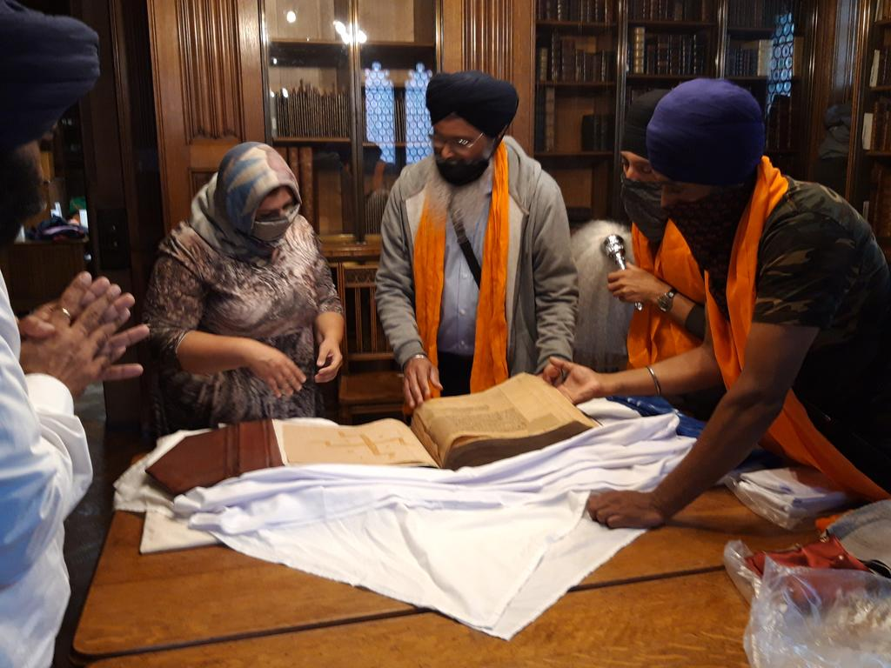
BENEFITS OF CONSERVING THE GURU GRANTH
Collaboration with a Sikh conservator and Pothi Seva, a charity for the conservation and preservation of printed and manuscript heritage, primarily sacred.
Physical access to the Sikh community.
Digitization and availability to all on Luna.
Notes:
The area/room where the Guru Granth Ji is being consulted or displayed should be a relatively small space.
Before retrieving, ensure to wear clean clothes, cover your hair, take your shoes and socks off, and wash your hands.
Make sure to not touch your feet or any other object before touching Guru Granth Sahib.
A head cover and no shoes are required while retrieving, transporting and consulting the manuscript. Shoe covers could be worn during transport to the consultation area.
The manuscript should be rested on a cushion and transported to the consultation room using a clean trolley.

