Slide 1
A view from afar – capturing learning experiences within a qualitative remote research project.
Sarah MacQuarrie
@SMQPsych
Dr. Sarah MacQuarrie http://www.manchester.ac.uk/research/sarah.macquarrie/
Senior Lecturer - Psychology of Education
Manchester Institute of Education. School of Environment, Education and Development
University of Manchester

Slide 2


About me

Slide 3
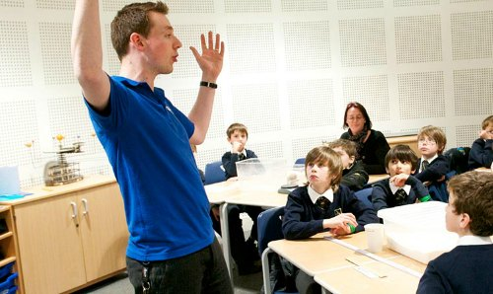

Slide 4
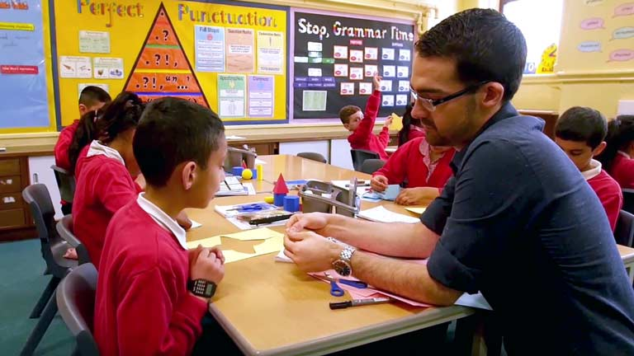

Slide 5
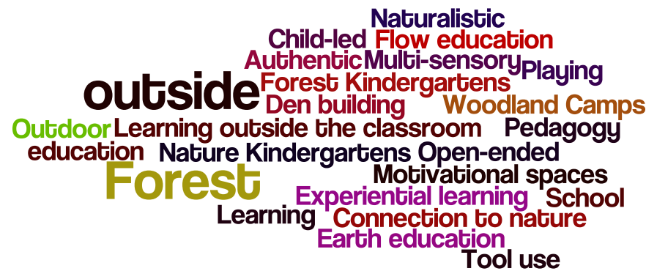

Slide 6

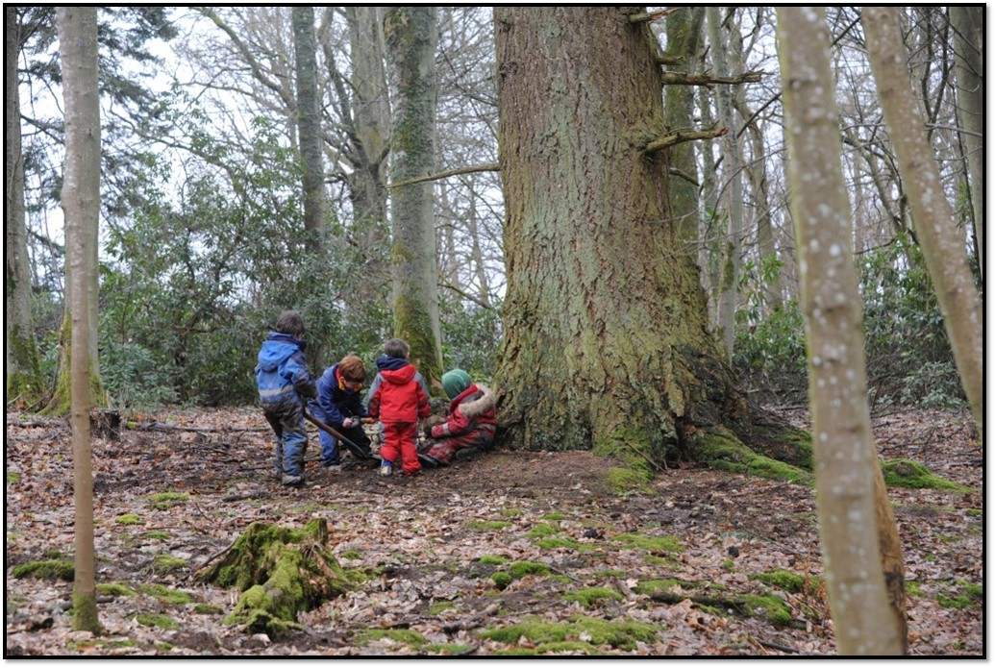
School-based model
MacQuarrie, S. (2018). Everyday teaching and outdoor learning: developing an integrated approach to support school-based provision. Education 3-13, 46(3), 345-361.
https://doi.org/10.1080/03004279.2016.1263968

Slide 7
Research design
Whole school approach
Schools and early years settings in Scotland and North of England
Duration – minimum 3 months, maximum 9 months
Children aged between 3-11, inclusive approach

Slide 8
School & local authority | Urban / rural | FSM + or - national average | Teaching year (age)
Primary 1A | Urban | Above | Nursery (4) Primary 1 (5)
Primary 2B | Remote town | Below | Primary 6-7 (10-12)
Primary 3B | Remote rural | Above | Primary 1-7 (5-12)
Primary 4C | Accessible rural | Below | Primary 1-2 (5-6)
Primary 5D | Accessible rural | Below | Nursery (4) ASN p1-2 (5-6) Primary 6 (10)
Nursery 6E | Rural town and fringe | n/a | Nursery school (3-4)
Primary 7E | Urban city and town | Below | Reception (4)
Primary 8F | Rural hamlet and isolated dwellings | Below | Years 3 & 4 (7-8) Reception, year 1, year2 (4-6)

Slide 9
Programme of activity
Phase1 - connection and appreciation of spaces
Phase 2 – contextual factors
considered the learning climate, in particular it probed practitioner's conception of adult and child interaction and how they recognised learning outdoors.
Phase 3 - extending learning –how/where/when to make connections

Slide 10
Theory
Programme of activity
Phase1 - connection and appreciation of spaces
Phase 2 – contextual factors
considered the learning climate, in particular it probed practitioner's conception of adult and child interaction and how they recognised learning outdoors.
Phase 3 - extending learning –how/where/when to make connections

Slide 11

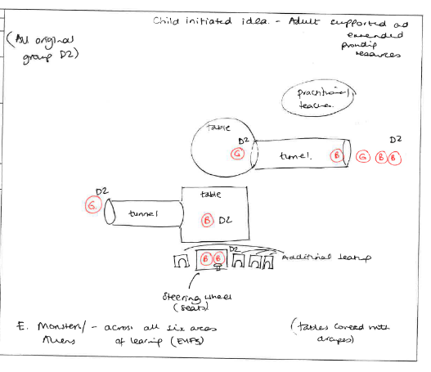

Findings
Data & evaluation
Survey
Reflective accounts
Map
Analysis

Slide 12
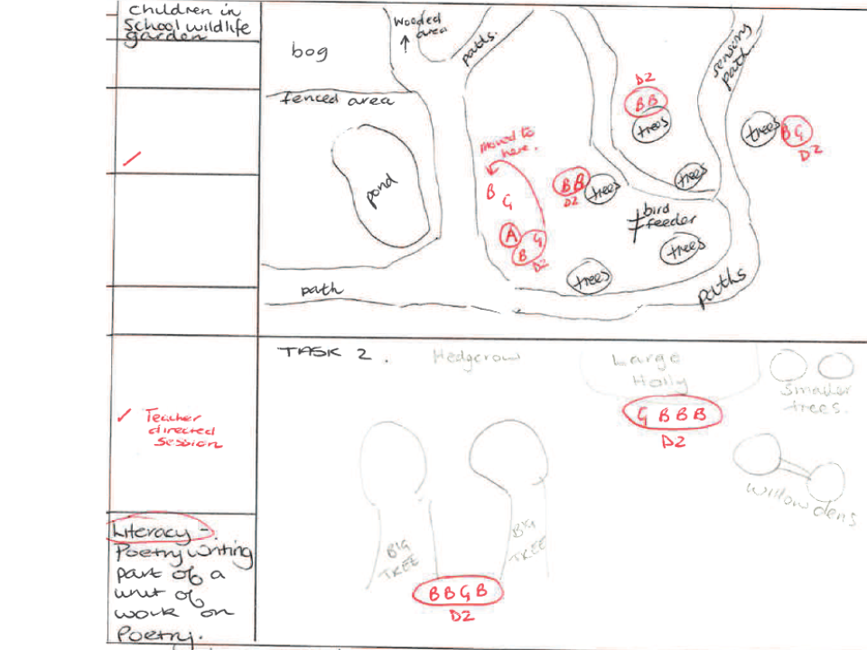
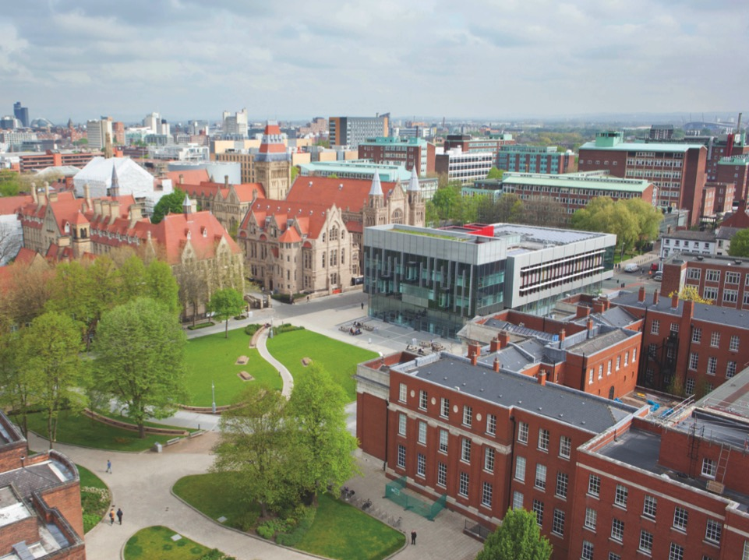

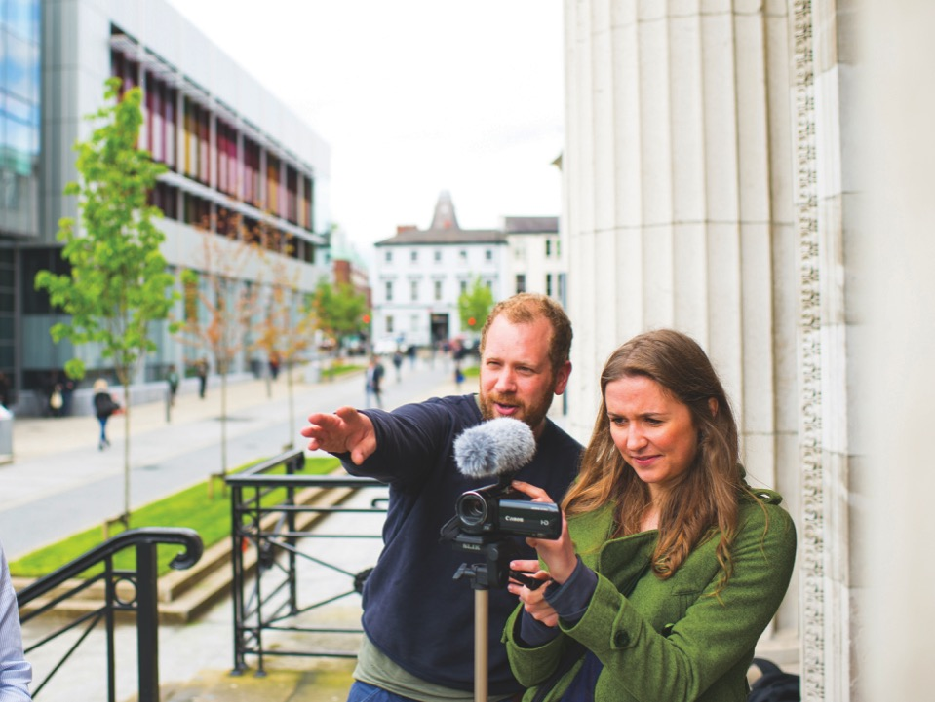

Slide 13
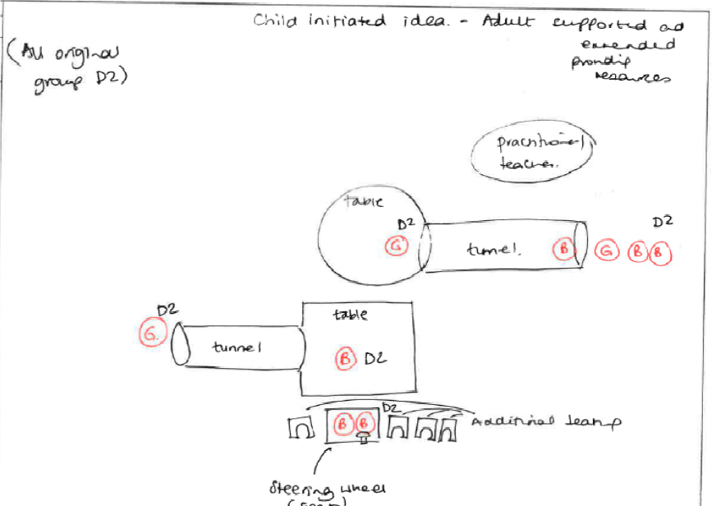
Be uniform in size
Compliment the content
Not impact on the copy area

Slide 14
Reflective accounts
Thematic map
Shared understanding and consultation
Integration of children’s ideas
Outdoor learning and curriculum coverage
Innovative teachers and collaborative action
Reviewing

Slide 15
Reflective accounts
Areas which I found interesting were often ignored and the children went to areas I would not have noticed, such as running down the hill and watching traffic at the fence. Participant 5Dii
In terms of places of interest, the children did not really recognise the paved area as an area of interest, even though I see them playing there most days… (consultation) was very useful to glean information about how we as staff regard the outdoors in comparison with how the children view it. Participant 8Fi
Shared understanding and consultation

Slide 16
Reflective accounts
Work at the sandpit was a direct result from the research project activity when pupils consulted on what they liked to do outdoors. Participant 1Aii
The children said the playground is better now that they are allowed to use the wildlife garden at playtimes.
Participant 4C
Integration of children’s ideas into activity

Slide 17
Reflective accounts
The class had some great times this year when we “just decided” to go outdoors. They really developed some leadership qualities and were so proud of themselves. Even in the extreme winds we had this year, we popped our heads outside to experience it and they’ve still not stopped talking about it. Prescriptive themes are much too overrated for activities like that.
Participant 5Diii
Outdoor learning and curriculum coverage

Slide 18
Reflective accounts
When I have taken the class outside I have often had a specific task in mind and been quite focussed on my outcome however taking part in this project has reawakened my old values that there is much to be gained from spontaneous play and child led learning. if something really absorbed the children I took time to tease out the learning in the moment and facilitated some individual or group exploration. Participant 4C
Innovative teachers and collaborative action

Slide 19
Reflective accounts
I find it useful to have many reviewing opportunities like “mini plenaries”, during lessons. This ensures the children consolidate learning frequently and allows me to check that there are no areas of uncertainty. Participant 8Fi
a few of the really quiet children have proved to be more engaged and confident when applying skills learned outdoors to new situations. Participant 4C
Reviewing - links spontaneous and guided learning opportunities

Slide 20
Discussion
Outdoor learning can complement wider school experience
Reflective diaries
Theory based approach appears optimal

Slide 21
Teacher engagement &
Teacher involvement
Remote Research Considerations
  Teacher time
  Knowledge gains or satisfaction?
  OL provides opportunity to
  explore pupil & teacher experiences
Relationship development
Teachers + reflective accounts
Researcher time

Slide 22



Thank you
Time for you to ask me anything!
sarah.macquarrie@ manchester.ac.uk
@SMQPsych

